Slide 1
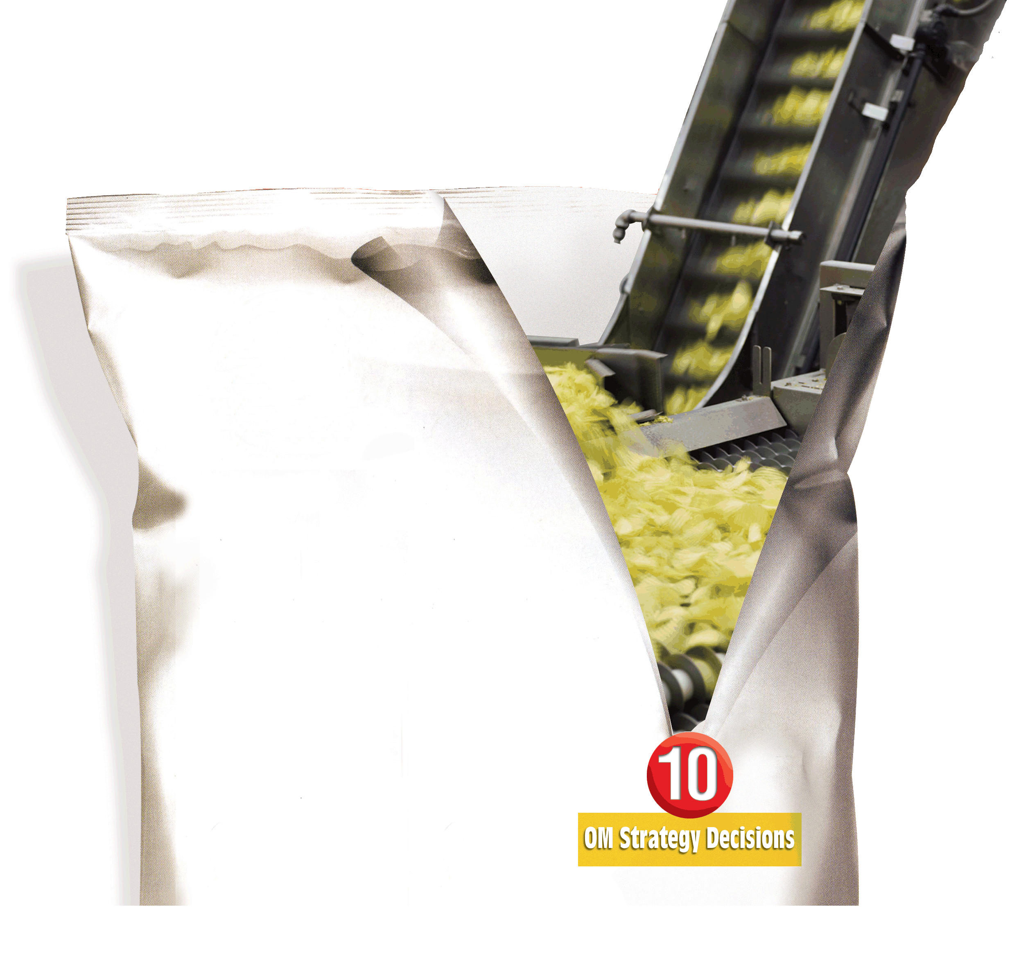
7
Process Strategy and Sustainability
PowerPoint presentation to accompany
Heizer and Render
Operations Management, 10e
Principles of Operations Management, 8e
PowerPoint slides by Jeff Heyl

Slide 2
Process Strategies
The objective of a process strategy is to build a production process that meets customer requirements and product specifications within cost and other managerial constraints

Slide 3
Process, Volume, and Variety
Figure 7.1
Volume
Low Volume
Repetitive Process
High Volume
High Variety
one or few units per run,
(allows customization)
Process Focus
projects, job shops (machine, print, hospitals, restaurants)
Arnold Palmer Hospital
Mass Customization
(difficult to achieve, but huge rewards)
Dell Computer
Changes in Modules
modest runs, standardized modules
Repetitive
(autos, motorcycles, home appliances)
Harley-Davidson
Changes in Attributes (such as grade, quality, size, thickness, etc.)
long runs only
Product Focus
(commercial baked goods, steel, glass, beer)
Frito-Lay
Poor Strategy (Both fixed and variable costs are high)

Slide 4
Process Strategies
How to produce a product or provide a service that
Meets or exceeds customer requirements
Meets cost and managerial goals
Has long term effects on
Efficiency and production flexibility
Costs and quality

Slide 5
Process Strategies
Four basic strategies
Process focus
Repetitive focus
Product focus
Mass customization
Within these basic strategies there are many ways they may be implemented

Slide 6
Process Focus
Facilities are organized around specific activities or processes
General purpose equipment and skilled personnel
High degree of product flexibility
Typically high costs and low equipment utilization
Product flows may vary considerably making planning and scheduling a challenge

Slide 7
Process Focus
Many inputs
(surgeries, sick patients, baby deliveries, emergencies)
(low volume, high variety, intermittent processes)
Arnold Palmer Hospital
Many departments and many routings
Figure 7.2(a)
Many different outputs (uniquely treated patients)

Slide 8
Repetitive Focus
Facilities often organized as assembly lines
Characterized by modules with parts and assemblies made previously
Modules may be combined for many output options
Less flexibility than process-focused facilities but more efficient

Slide 9
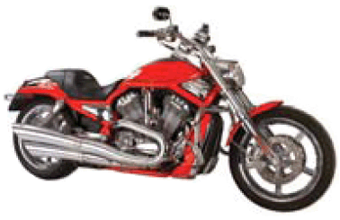
Repetitive Focus
Raw materials and module inputs
(multiple engine models, wheel modules)
Few modules
(modular)
Harley Davidson
Figure 7.2(b)
Modules combined for many
Output options
(many combinations of motorcycles)

Slide 10
Product Focus
Facilities are organized by product
High volume but low variety of products
Long, continuous production runs enable efficient processes
Typically high fixed cost but low variable cost
Generally less skilled labor

Slide 11
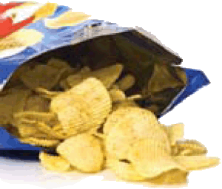
Product Focus
Few Inputs
(corn, potatoes, water, seasoning)
(low-volume, high variety, continuous process)
Frito-Lay
Output variations in size, shape, and packaging
(3-oz, 5-oz, 24-oz package labeled for each material)
Figure 7.2(c)

Slide 12
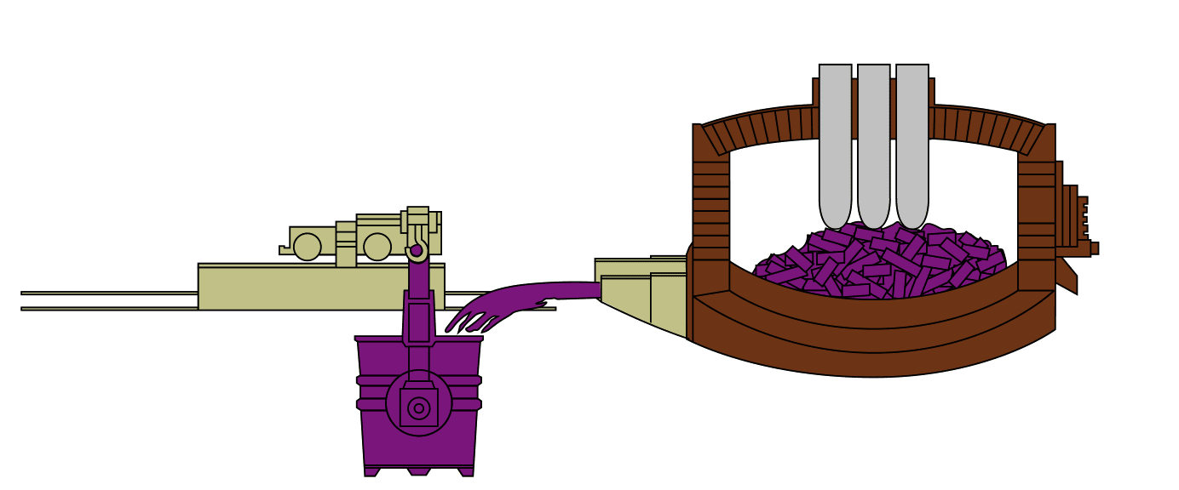
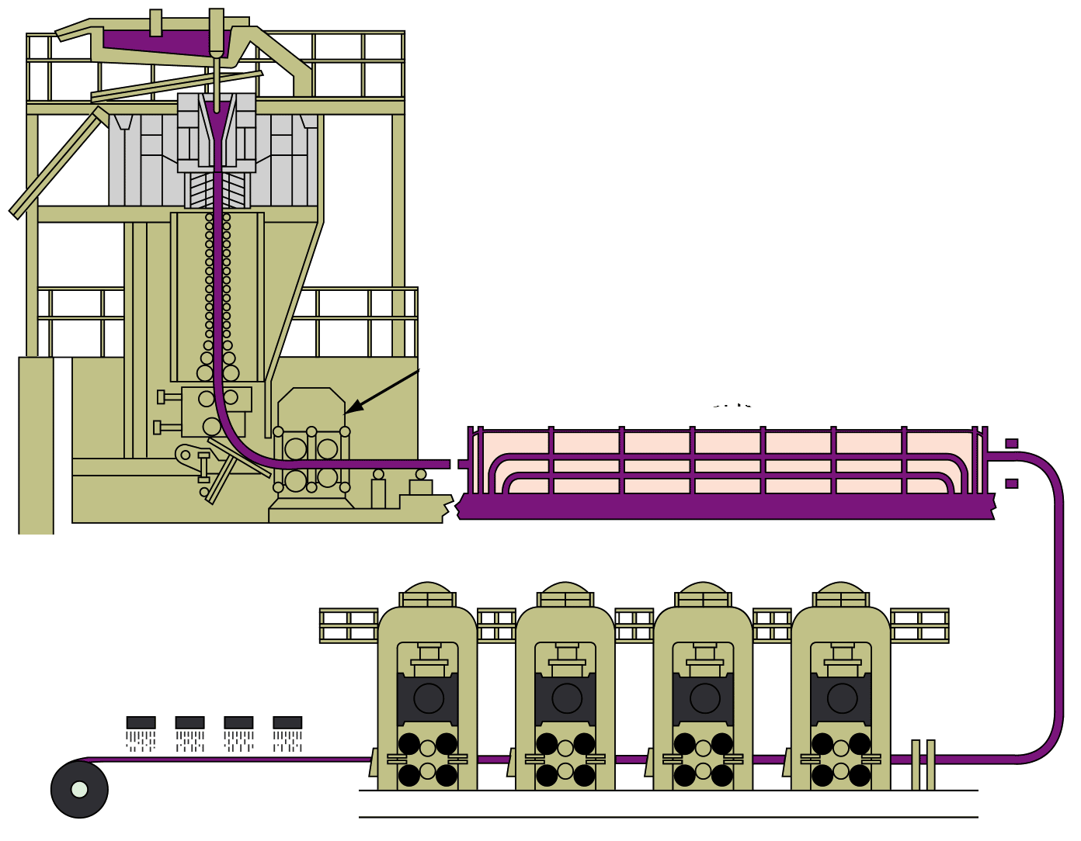
Product Focus
D
Nucor Steel Plant
A
Scrap steel
C
B
Electric furnace
Continuous caster
Ladle of molten steel
Continuous cast steel sheared into 24-ton slabs
Hot tunnel furnace - 300 ft
E
F
Hot mill for finishing, cooling, and coiling
H
G
I

Slide 13
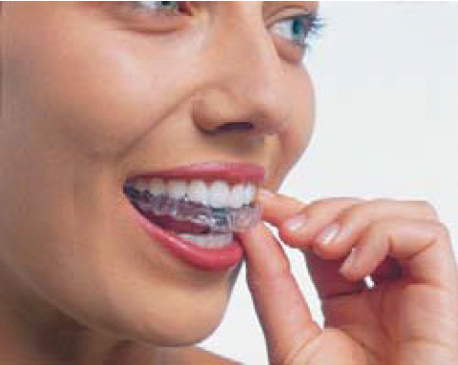
Mass Customization
The rapid, low-cost production of goods and service to satisfy increasingly unique customer desires
Combines the flexibility of a process focus with the efficiency of a product focus

Slide 14
Mass Customization
Number of Choices
Item 1970s 21st Century
Vehicle models 140 286
Vehicle types 18 1,212
Bicycle types 8 211,000
Software titles 0 400,000
Web sites 0 162,000,000
Movie releases per year 267 765
New book titles 40,530 300,000
Houston TV channels 5 185
Breakfast cereals 160 340
Items (SKUs) in 14,000 150,000
supermarkets
LCD TVs 0 102
Table 7.1

Slide 15
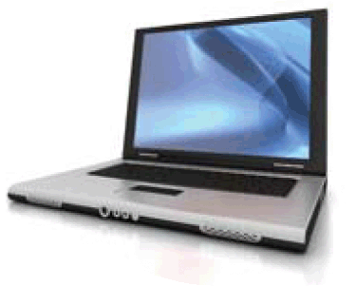
Mass Customization
Many parts and component inputs
(chips, hard drives, software, cases)
Many modules
(high-volume, high-variety)
Dell Computer
Figure 7.2(d)
Many output versions
(custom PCs and notebooks)

Slide 16
Mass Customization
Repetitive Focus
Flexible people and equipment
Figure 7.3
Modular techniques
Accommodating Product and Process Design
Responsive Supply Chains
Mass Customization
Rapid throughput techniques
Effective scheduling techniques
Process-Focused
High variety, low volume
Low utilization (5% to 25%)
General-purpose equipment
Product-Focused
Low variety, high volume
High utilization (70% to 90%)
Specialized equipment

Slide 17
Mass Customization
Imaginative and fast product design
Rapid process design
Tightly controlled inventory management
Tight schedules
Responsive supply chain partners

Slide 18
Crossover Charts
Variable costs
$
Variable costs
$
Variable costs
$
Fixed costs
Fixed costs
Fixed costs
Low volume, high variety
Process A
Repetitive
Process B
High volume, low variety
Process C
$
Total cost
Total cost
Total cost
400,000
300,000
200,000
Fixed cost Process C
Fixed cost Process B
Fixed cost Process A
Figure 7.4
(2,857)
V₁
V₂
(6,666)
Volume

Slide 19
Focused Processes
Focus brings efficiency
Focus on depth of product line rather than breadth
Focus can be
Customers
Products
Service
Technology

Slide 20
Changing Processes
Difficult and expensive
May mean starting over
Process strategy determines transformation strategy for an extended period
Important to get it right

